Slide 1
UNIT IV FIR FILTER DESIGN 1.Structures of FIR – 2.Linear phase FIR filter – 3.Filter design using windowing techniques, 4.Frequency sampling techniques – 5.Finite word length effects in digital Filters

Slide 2




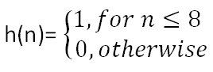

Slide 3

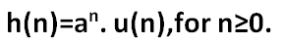


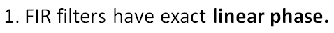
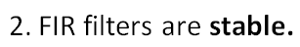

Slide 4
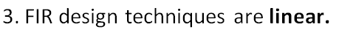
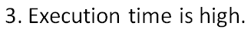

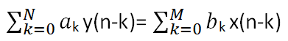
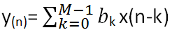

Slide 5

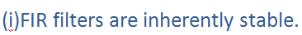




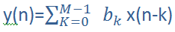

Slide 6

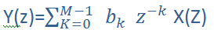
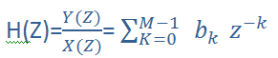

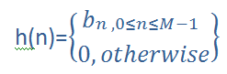

Slide 7


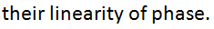
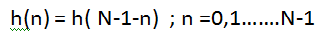



Slide 8
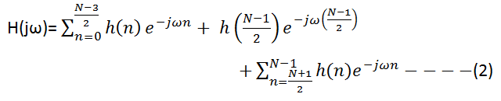
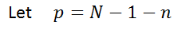
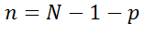

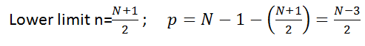
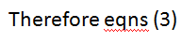
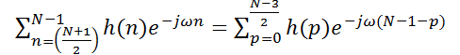

Slide 9
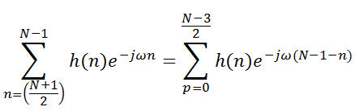
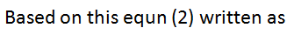
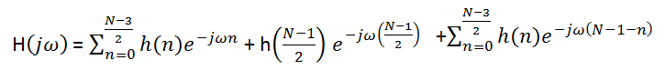
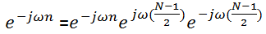
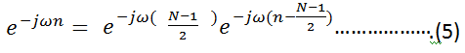

Slide 10

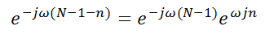
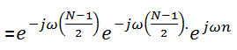
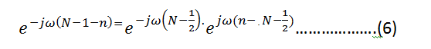

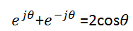


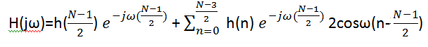

Slide 11
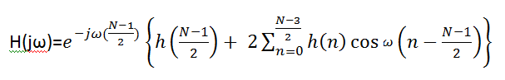
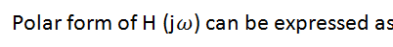
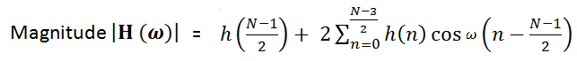
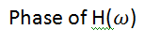
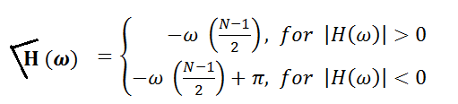

Slide 12
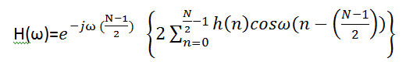
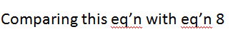
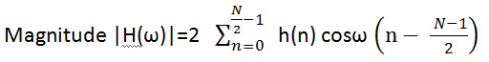
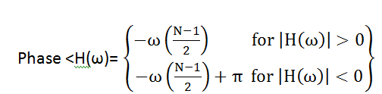
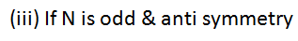
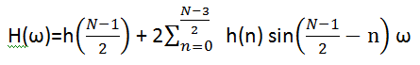

Slide 13
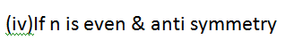
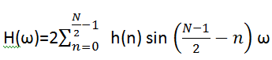
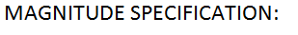
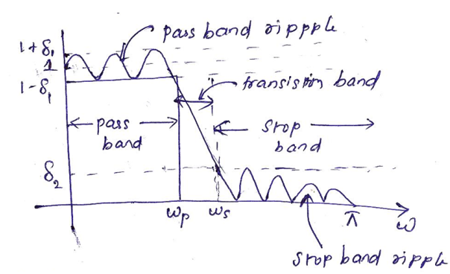
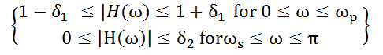

Slide 14

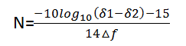
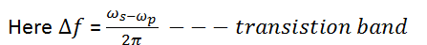
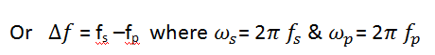




Slide 15










Slide 16




Here α =

Slide 17






Slide 18





Slide 19





Slide 20










Slide 21






Slide 22




Slide 23






Slide 24







Slide 25




Slide 26








Slide 27





Slide 28






Slide 29





Slide 30




Slide 31




Slide 32






Slide 33





Slide 34





Slide 35




Slide 36








Slide 37








Slide 38








Slide 39






Slide 40



Slide 41







Slide 42









Slide 43









Slide 44









Slide 45







Slide 46








Slide 47








Slide 48










Slide 49












Slide 50










Slide 51






Slide 52











Slide 53










Slide 54



Slide 55








Slide 56








Slide 57


Slide 58









Slide 59









Slide 61



Slide 62





Slide 63


Slide 64














= 0 ; 0.5π

Slide 65





Slide 66








Slide 67








Slide 68



Slide 69




Slide 70
KAISER WINDOW
A window function with minimum stop band attenuation has maximum main lobe width.
In kaiser, the side lobe level can be controlled w.r.t the main lobe by varying the parameter “α”
Steps to design:
1.Find hd(n)
2.Choose §

Slide 71
3.calculate αs;
4.find α
5.choose ‘D’
6.Choose ‘N’
7.Compute window seq Wk(n)
8.Compute h(n)= Wk(n) hd(n)
9.Find H(Z)
10.Find H(w)

Slide 72
Finite word length effects:
1.When the numbers are represented in digital form, errors are introduced called finite precision effect or finite word length effect.
2. Types of quantisation error
Input Quantization error
Product quantization error
Coefficient quantization error
3.Types of number representation
1.Fixed 2.floating 3.block floating point

Slide 73
Fixed point:
(i) Sign magnitude form
(ii) 1’s complement form
(iii) 2’s complement form
4.Quantization error:
Error due to truncation
Error due to rounding
5.Quantization noise power:
Input noise power(ii) output noise power
6.Limit cycle oscillations

